Slide 2
Ending Polio : the Final Push
It’s time for checkmate
Dr Bernard Chan
PolioPlus Committee Chair

Slide 3
Why polio?
The world is better
without polio.

Slide 4
Why polio?
Polio is a severe. It attacks the nerves and causes paralysis, and severe permanent disability.
Treating and caring for a child with polio is costly in many ways.
It is possible to prevent polio.

Slide 5
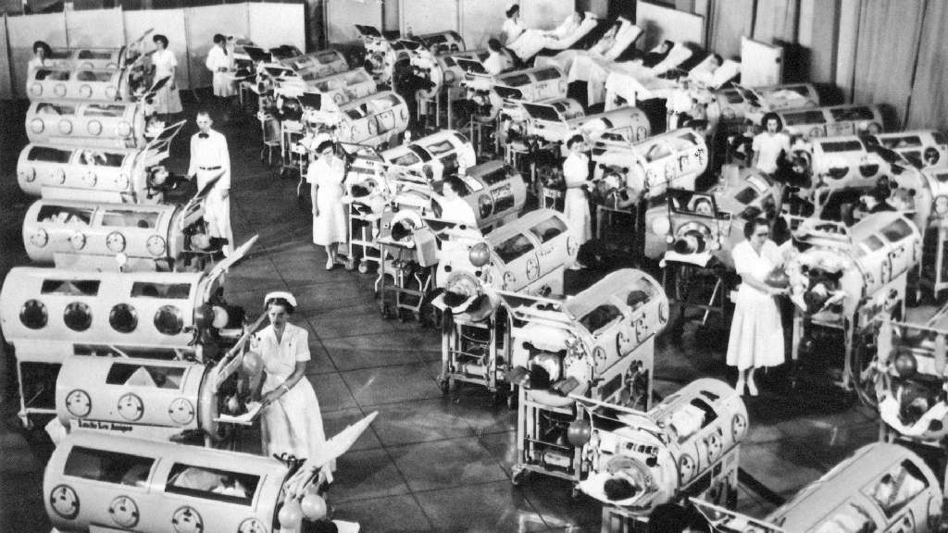
'About 25,000 people were paralysed in and around New York, and 6,000 of those died.'
- in 1916

Slide 6
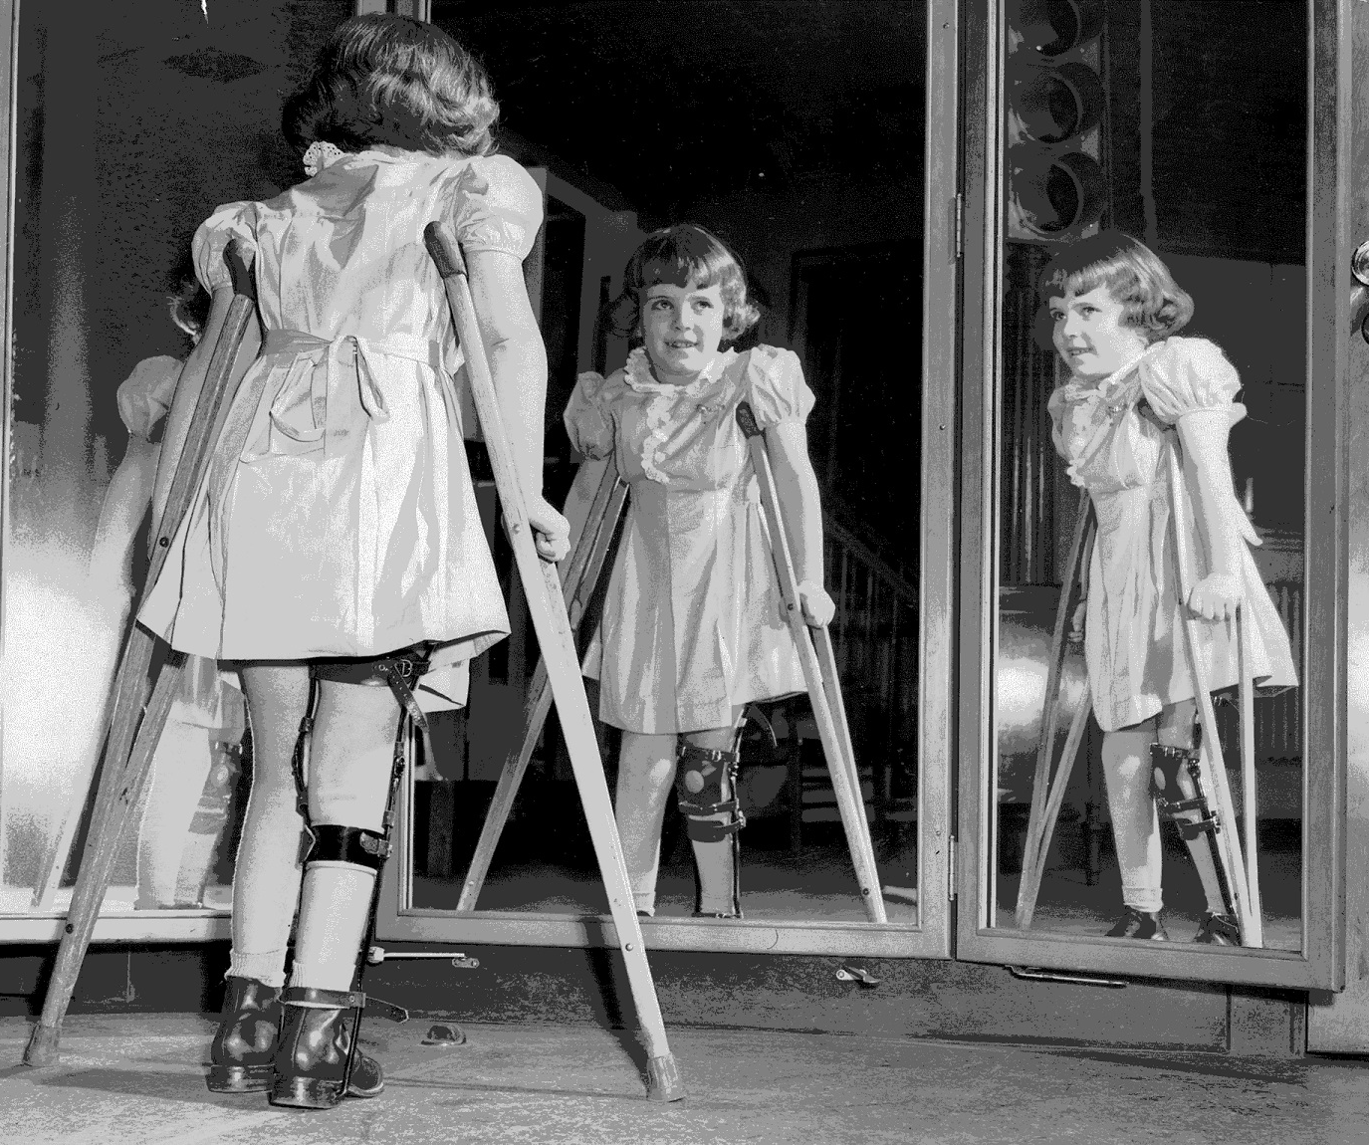
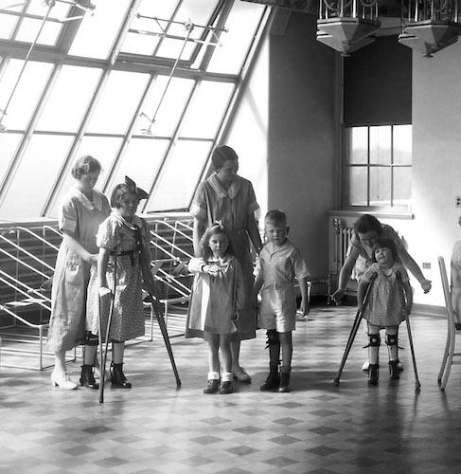
Polio is crippling
Polio is permanent

Slide 7
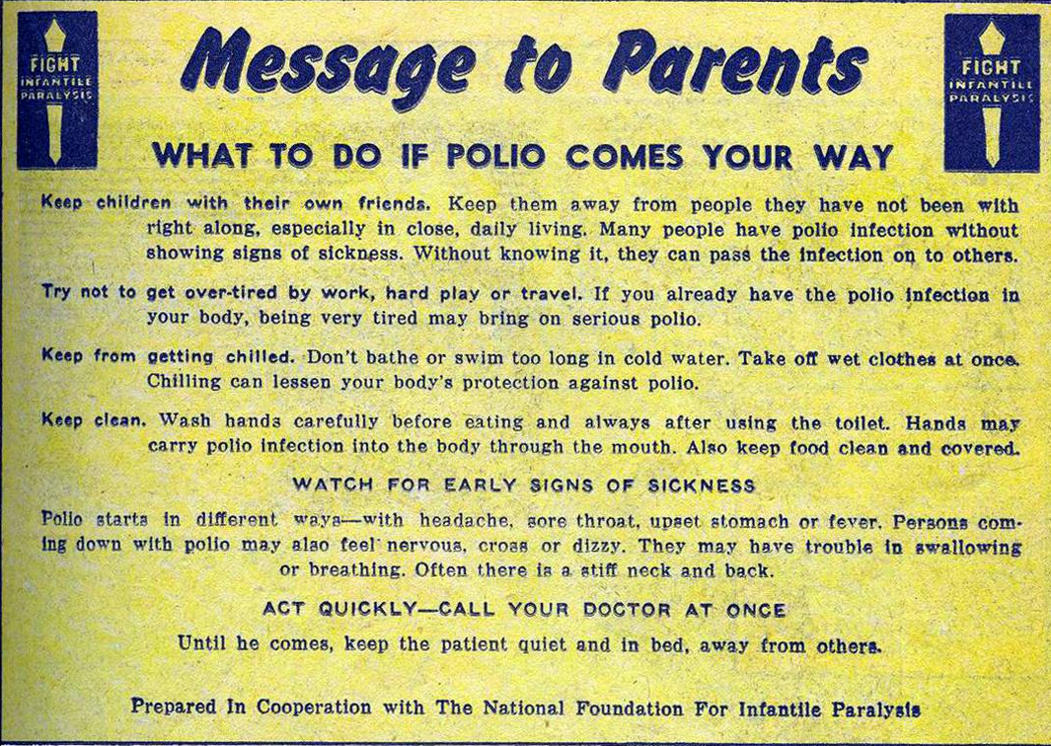

Slide 8
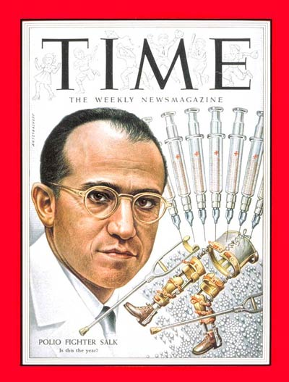
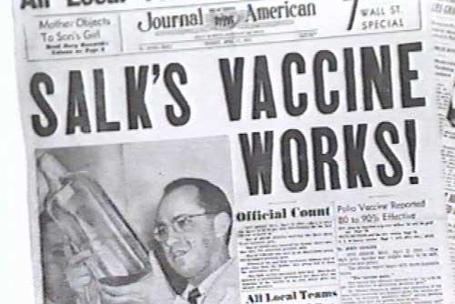
Polio can be prevented with a vaccine.

Slide 9
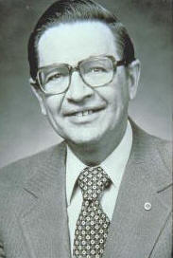
In 1979, RI President Sir Clem Renouf and District 7620 Governor Dr John Sever pushed for a partnership by Rotary with governments around the world to eradicate a disease from the face of the earth.
In 1985, PolioPlus was born.

Slide 10
Before launching an ambitious program in 1985 to protect all the world's children against the crippling disease of polio, Rotary's leadership deliberated at length over the initiative's name. "Polio" was chosen to signal Rotary's quest for a polio-free world, and "plus" was added to express Rotary's conviction that a focused attack on polio would also spur a dramatic increase in immunizations against the five other childhood vaccine-preventable diseases targeted by WHO's Expanded Programme on Immunization: measles, tuberculosis, diphtheria, whooping cough, and tetanus.

Slide 11
In 1988, Global Polio Eradication Initiative was formed, being a partnership between national governments, WHO, Rotary, the US CDC and UNICEF.

Slide 12
What is the money for?

Slide 13
Polio Eradication and End-Game Strategic Plan (PEESP) 2013-2019
Top 5 Costs
Supplement vaccination work in a number of countries
Cost of Vaccines
Surveillance, including establishing and running labs
Switch from oral polio vaccine to inactivated polio vaccine
Communications, engagement & social mobilization

Slide 14
Where is the money coming from?
Top 5 Funding (2013 to 2016) | Confirmed funding (as of 1 April 2016) (in millions US dollars) | Percentage
Bill & Melinda Gates Foundation | 1,108 | 29%
United Kingdom | 481 | 13%
USA | 402 | 11%
The Rotary Foundation | 345 | 9%
Islamic Development Bank /Government of Pakistan | 225 | 6%
Others | 1,231 | 32%
TOTAL | 3,791 | 100%

Slide 17
What can we do now?

Slide 18
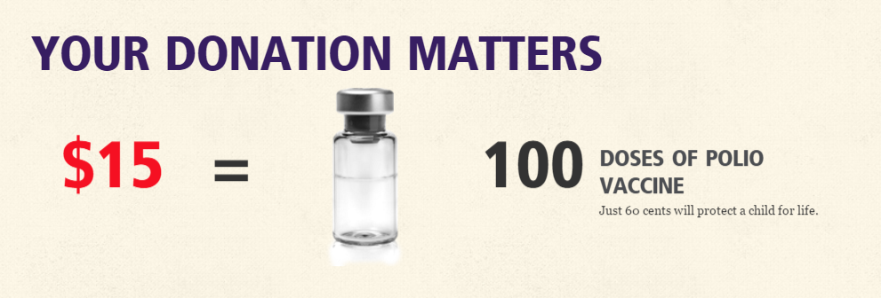
1. Give to TRF's PolioPlus:
https://map.rotary.org/en/securememberservices/Pages/SelectFundR.aspx?FUND=P
Every dollar you give is matched another 2 dollars by Bill and Melinda Gates Foundation.

Slide 19
2. If your club is having any EndPolioNow program, fund-raising or public image program, please keep us updated. Let us help in any way we can.
3. Keep updated with #EndPolioNow at http://www.endpolio.org/

Slide 20
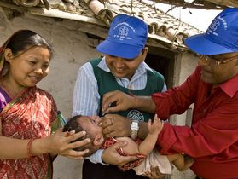
4. World Polio Day is on 24th October every year. Learn how you can promote Rotary's signature program here:
http://www.endpolio.org/worldpolioday.
Resources for #EndPolioNow projects, web/social media and print publications are available at
http://www.endpolio.org/worldpolioday/#resources

Slide 21
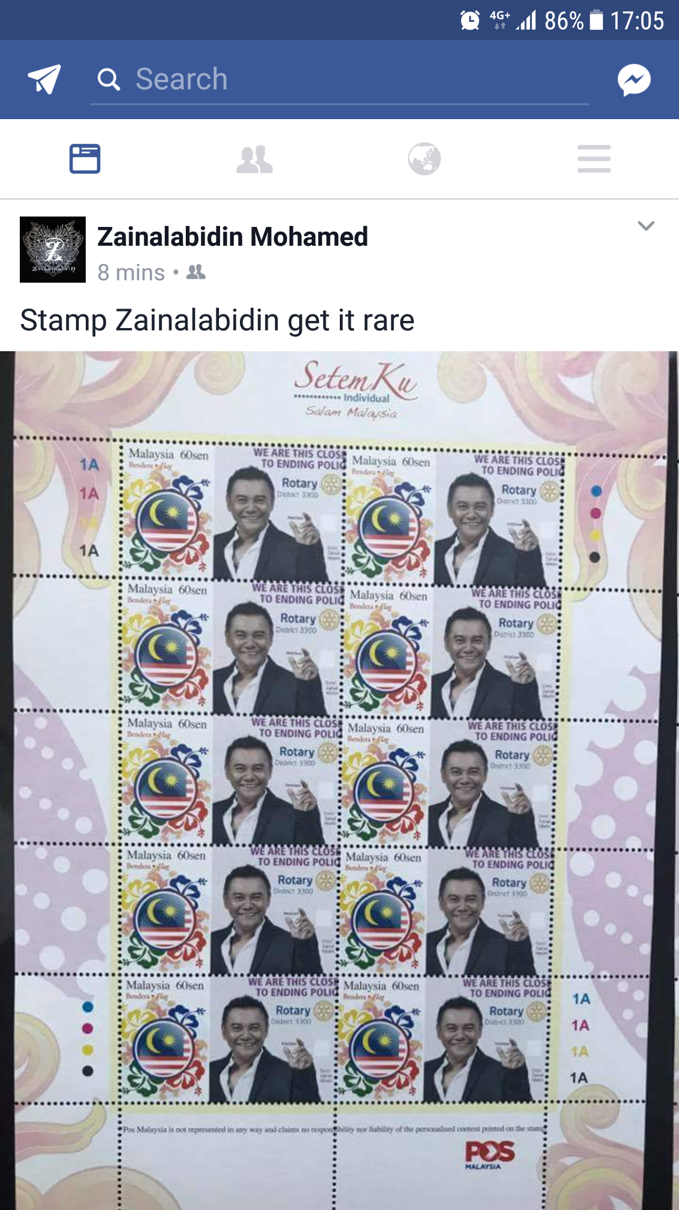

Slide 22
The World’s Greatest Meal

Slide 23
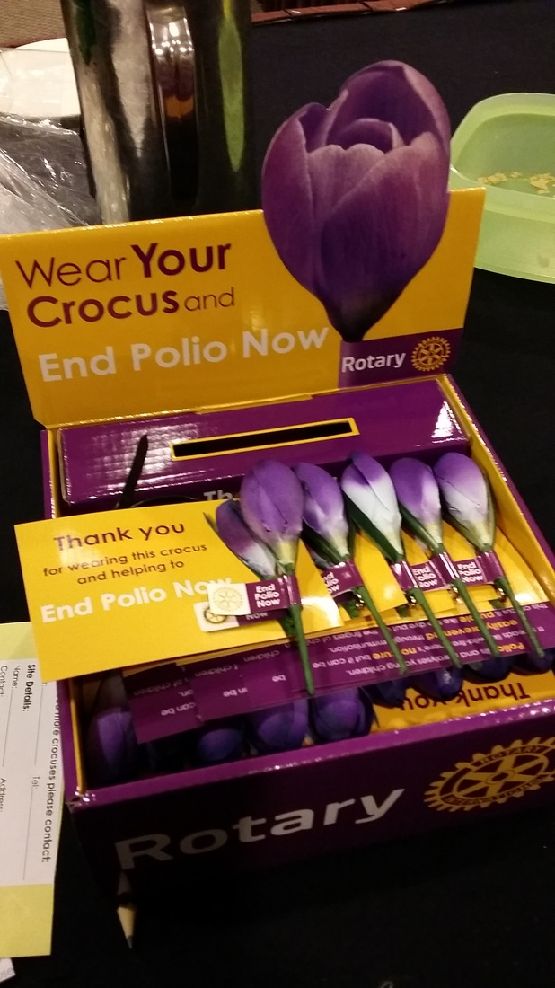
Rotary Crocuses

Slide 24
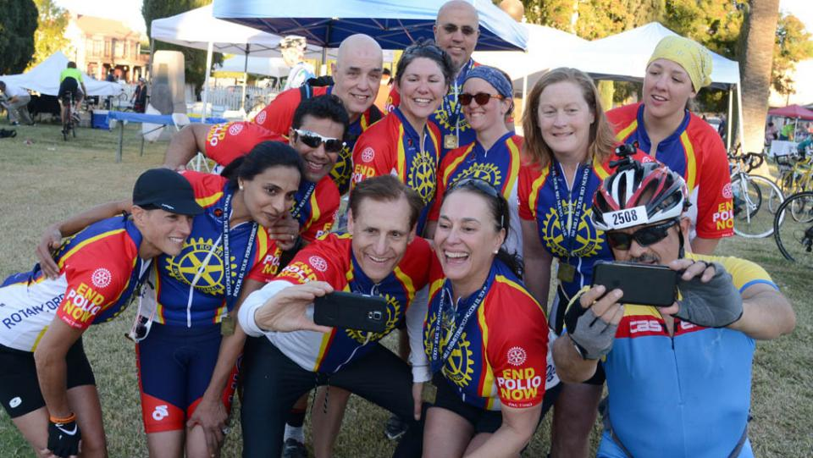
Miles to End Polio

